Slide 1
Introduction to PHP
Course Code: CSC 3222
Course Title: WEB TECHNOLOGIES
Dept. of Computer Science
Faculty of Science and Technology
Lecturer No: | 2 | Week No: | 2 | Semester: | Fall 2024-2025
Lecturer: | MD.AL-AMIN (alamin@aiub.edu)

Slide 2
Introduction to PHP
Learning Objectives
PHP
What Can PHP Do?
PHP Installation
PHP Script
Run in Browser
PHP Syntax
Comments
Variables
Array
PHP Data Types
Boolean and Array
Object
Loop
conditional Statement
Functions
Class and Object

Slide 3
Learning Objectives
In this lecture , we will learn more details about "PHP: Hypertext Preprocessor“.
Discussing the advantage and importance of PHP.
Familiar with PHP language and its basic data structure.

Slide 4
PHP
PHP is a server scripting language, and a powerful tool for making dynamic and interactive Web pages.
PHP 7 is the latest stable release.
PHP is an acronym for "PHP: Hypertext Preprocessor"
PHP scripts are executed on the server
PHP files can contain text, HTML, CSS, JavaScript, and PHP code
PHP code is executed on the server, and the result is returned to the browser as plain HTML
PHP files have extension ".php"

Slide 5
What Can PHP Do?
PHP can generate dynamic page content
PHP can create, open, read, write, delete, and close files on the server
PHP can collect form data
PHP can send and receive cookies
PHP can add, delete, modify data in your database
PHP can be used to control user-access
PHP can encrypt data

Slide 6
PHP Installation
Install XAMPP in your PC or server.
XAMPP is the most popular PHP development environment
Apache + MariaDB(Mysql) + PHP + Perl
Basic PHP Syntax
<?php echo "Hello World!"; ?>
Save the file as HelloWorld.php in htdocs in Apache XAMPP.
Start the server and browse http://localhost/HelloWorld.php in the browser. (We will see details in the Lab class.)

Slide 7
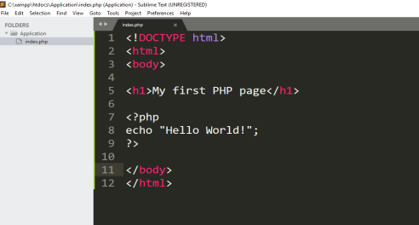
PHP Script
A PHP script can be placed anywhere in the document.
A PHP script starts with <?php and ends with ?>
keywords (e.g. if, else, while, echo, etc.), classes, functions, and user-defined functions are not case-sensitive.

Slide 8
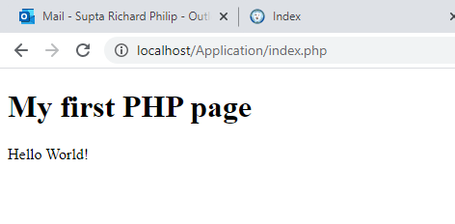
Run in Browser
Start the server and browse http://localhost/Application/index.php in the browser. (We will see details in the Lab class.)

Slide 9
PHP Syntax
Comments
<?php // This is a single-line comment # This is also a single-line comment ?>
<?php /* This is a multiple-lines comment block that spans over multiple lines */ ?>

Slide 10
PHP Syntax
Variables
In PHP, a variable starts with the $ sign, followed by the name of the variable.
Variable names are case-sensitive ($age and $AGE are two different variables).
<?php $txt = "Hello world!"; $x = 5; $y = 10.5;
echo "I love " . $txt . "!";
echo $x + $y; ?>

Slide 11
PHP Data Types
Boolean and Array
PHP supports the following data types: String, Integer, Float (floating point numbers - also called double), Boolean, Array, Object, NULL.
A Boolean represents two possible states: TRUE or FALSE.
$x = true; $y = false;
An array stores multiple values in one single variable.
In the following example $cars is an array. The PHP var_dump() function returns the data type and value:
<?php $cars = array("Volvo","BMW","Toyota"); var_dump($cars); ?>
OUTPUT:
array(3) {
[0] => string(5) "Volvo"
[1] => string(3) "BMW"
[2] => string(6) "Toyota"
}

Slide 12
PHP Data Types
PHP Object
An object is a data type which stores data and information on how to process that data.
In PHP, an object must be explicitly declared.
<?php class Car { function Car() { $this->model = "VW"; } } // create an object $herbie = new Car(); // show object properties echo $herbie->model; ?>

Slide 13
PHP Loop
The PHP while Loop and do...while Loop
<?php $x = 1; while($x <= 5) { echo "The number is: $x <br>"; $x++; } ?>
<?php $x = 1; do { echo "The number is: $x <br>"; $x++; } while ($x <= 5); ?>

Slide 14
PHP for and foreach Loop
The foreach loop works only on arrays, and is used to loop through each key/value pair in an array.
<?php for ($x = 0; $x <= 10; $x++) { echo "The number is: $x <br>"; } ?>
<?php $colors = array("red", "green", "blue", "yellow"); foreach ($colors as $value) { echo "$value <br>"; } ?>

Slide 15
PHP conditional Statement
If else
Conditional statements are used to perform different actions based on different conditions.
<?php
$a =20;
$b = 30; if ($a > $b) { echo "a is bigger than b"; } elseif ($a == $b) { echo "a is equal to b"; } else { echo "a is smaller than b"; } ?>

Slide 16
PHP conditional Statement
Switch
HTTP stands for Hyper Text Transfer Protocol The switch statement is used to perform different actions based on different conditions.
<?php $favcolor = "red"; switch ($favcolor) { case "red": echo "Your favorite color is red!"; break; case "green": echo "Your favorite color is green!"; break; default: echo "Your favorite color is neither red, blue, nor green!"; } ?>

Slide 17
PHP Functions
PHP has more than 1000 built-in functions, and in addition you can create your own custom functions.
<?php function addNumbers(int $a, int $b) { return $a + $b; } echo addNumbers(5, 5); ?>

Slide 18
PHP - Classes and Objects
<?php class Fruit { // Properties public $name; // Methods function set_name($name) { $this->name = $name; } function get_name() { return $this->name; } } $apple = new Fruit(); $apple->set_name('Apple'); echo $apple->get_name(); ?>

Slide 19
Books
W3Schools Online Web Tutorials; URL: http://www.w3schools.com
PHP Documentation; URL: http://www.php.net/docs.php
Sams Teach Yourself Ajax JavaScript and PHP All in One; Phil Ballard and Michael Moncur; Sams Publishing; 2010
JavaScript Phrasebook; Christian Wenz; Sams Publishing; 2007
PHP and MySQL Web Development, 4/E; Luke Welling and Laura Thomson; Addison-Wesley Professional; 2009
JavaScript for Programmers Paul J. Deitel and Harvey M. Deitel; Prentice Hall; 2009
Beginning PHP5, Apache, and MySQL Web Development; Elizabeth Naramore, Jason Gerner, Yann Le Scouarnec, Jeremy Stolz and Michael K. Glass; Wiley Publishing; 2005
XML in a Nutshell, 3/E; Elliotte Rusty Harold and W. Scott Means; O'Reilly Media; 2004

Slide 20
References
https://www.ntu.edu.sg/home/ehchua/programming/webprogramming/HTTP_Basics.html
https://developer.mozilla.org/enUS/docs/Web/HTTP/Status
https://www.w3schools.com/html/html_intro.asp
https://www.w3schools.com/html/html_xhtml.asp

